Slide 1
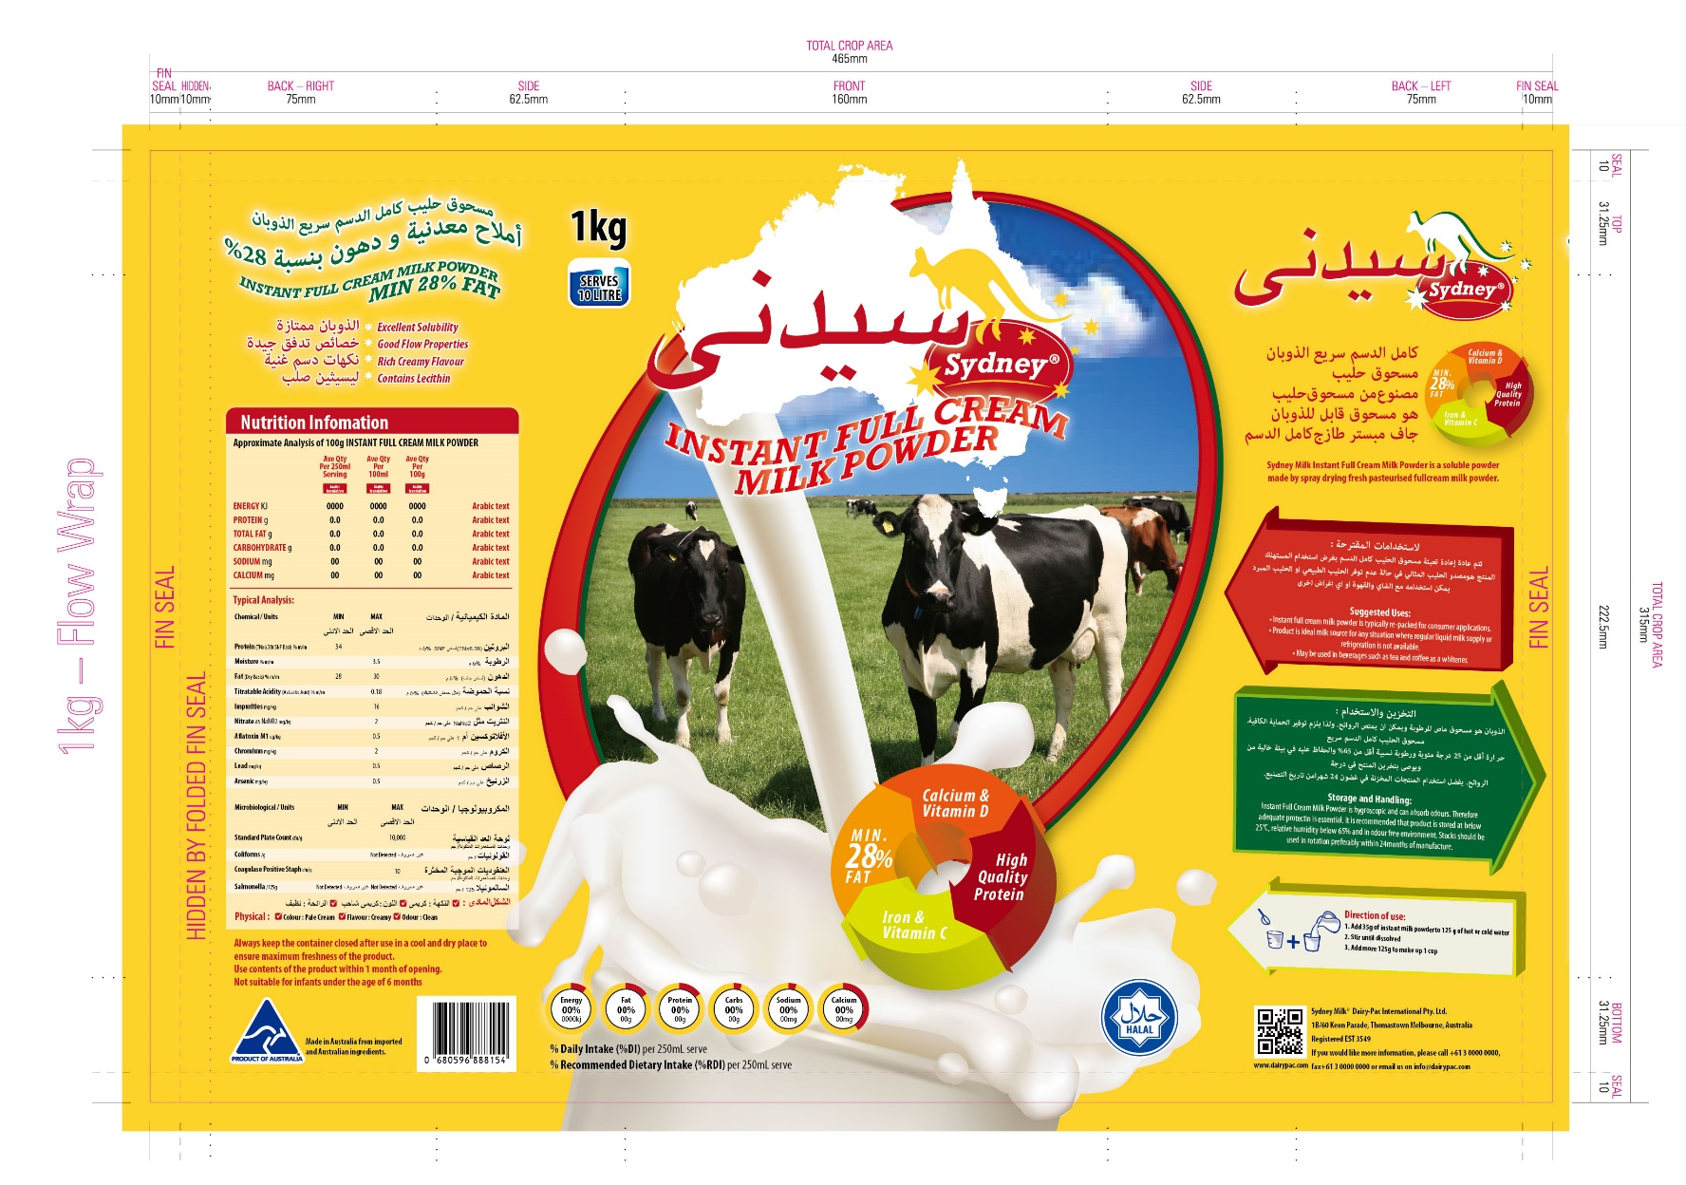


Sydney Instant Milk Powder
High quality nutritious Australian milk powder

Slide 2
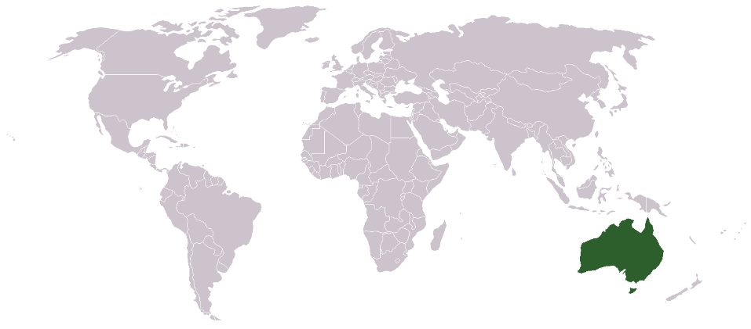
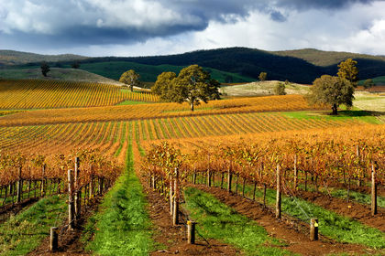
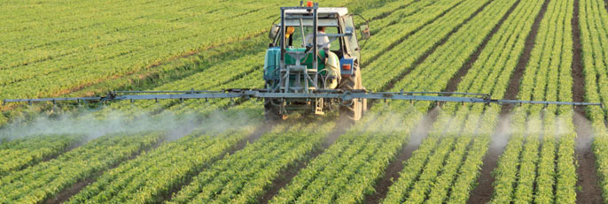
Australia - an ideal location for food production
Australia—owing to its size and isolation—is often dubbed the "island continent", and is sometimes considered the world’s largest island.
The population density, 2.8 inhabitants per square kilometre, is among the lowest in the world.
Australia's size gives it a wide variety of landscapes, with tropical rainforests in the north-east, mountain ranges in the south-east, south-west and east, and dry desert in the centre.
Australia is a major agricultural producer and exporter and has earned a global reputation for its expertise in agriculture and the high quality of its produce.

Slide 3
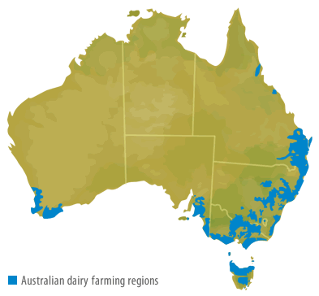
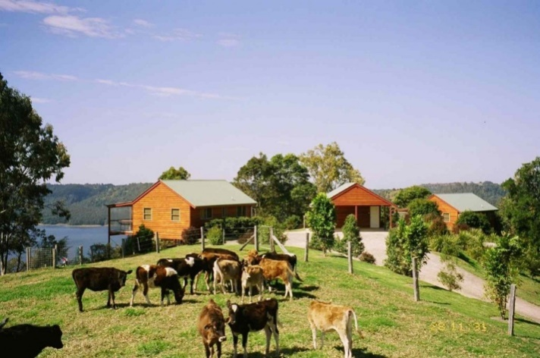
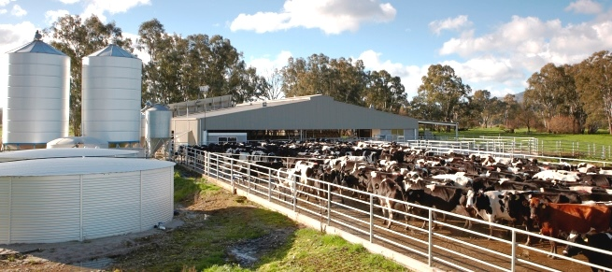
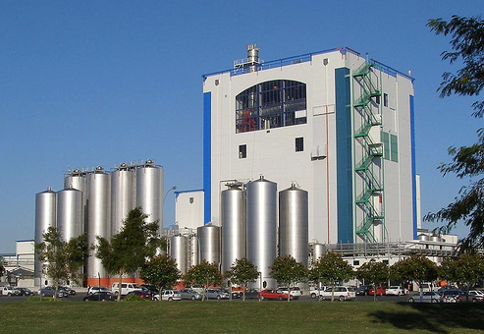
Australia has an ideal climate for milk productions
Australia’s geographic location together with strict quarantine laws has played a critical role in seeing it become one of the few countries in the world to remain free from the world’s most severe pests and diseases.
Consequently Australia’s food and agricultural products are well known for being safe, nutritious and high quality. Australia’s dairy industry is no exception with Australian dairy products being recognised as superior and in demand all over the world.
Although dairy farms can be found all over Australia, our milk is produced mainly in the traditionally higher rainfall areas in the south-eastern corner of Australia. This is where most dairy products are produced.
South-eastern Australia's climate is ideal for cows as they like cool to warm temperatures and areas where there is plenty of water to grow the rich pastures that they love to eat. Dairy farms are also found inland, where water for irrigation is available, and pastures are easy to grow.

Slide 4
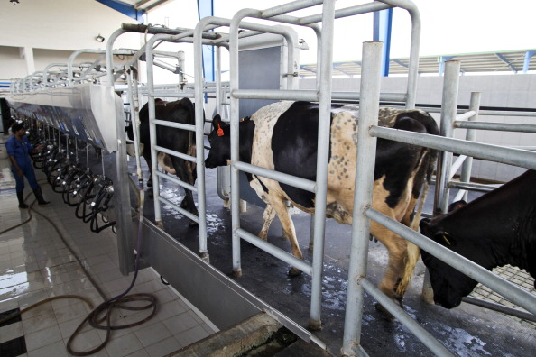
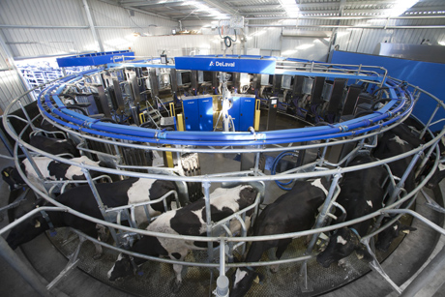
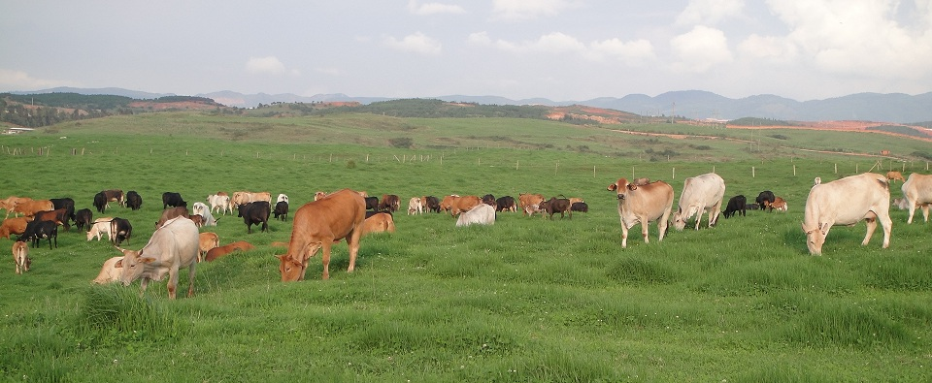
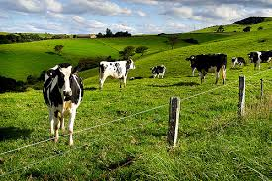
Healthy Cows are key for quality milk
In Australia, dairy farmers follow strict food safety requirements to ensure that the cows stay healthy and produce high-quality milk. Each dairy cow is identified with a unique ear tag that helps the farmer to monitor them regularly. Dairy farmers keep records of all feed provided and any health problems of (or medical treatments given to) each cow.
Farmers see each cow every day and are very good at identifying sick cows. Sick cows are kept separately from the rest of the herd and only re-join the herd when they are well again. Dairy farmers must keep their milking equipment and milking sheds very clean.
Cows need to drink a large volume of fresh water every day and farmers make sure the water is fresh and that there is always plenty to go around. They also ensure that their cows are given a balanced diet which gives them enough energy, vitamins & minerals to produce the best milk which in turn allows us to bring you the best milk powder.

Slide 5
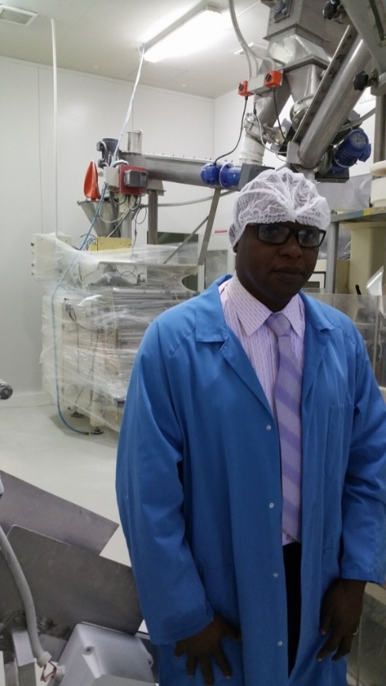
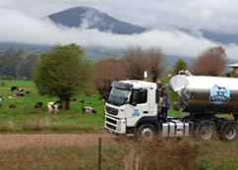
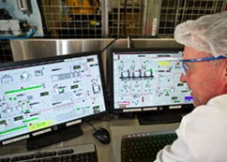
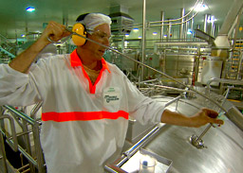
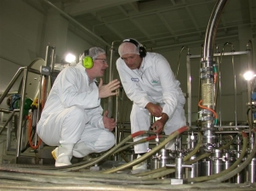
Advanced manufacturing process
Tankers transport the milk from dairy farms to the nearest milk processing plant. These are located near the farms so the milk doesn't have far to travel. On arrival, milk from the tanker is tested again in a laboratory to ensure that it has been kept at or below 4 degrees Celsius during transport, and has been delivered within 24 hours of milking. The tests also monitor protein levels and check for the presence of bacteria and antibiotics. The milk is then pumped into large insulated vats at the factory ready to be turned into high quality milk powder.
Manufacturing and packing of our milk powder meets the high standards required by the Dairy Industry Food Act, Export Control (Milk & Milk Products) HACCP & GMP.

Slide 6

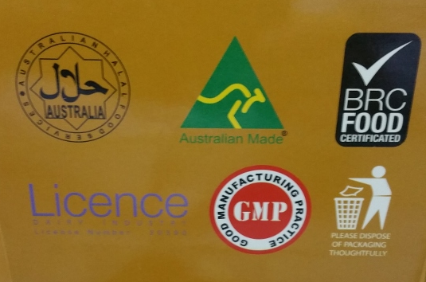
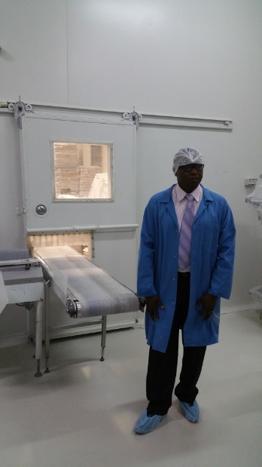
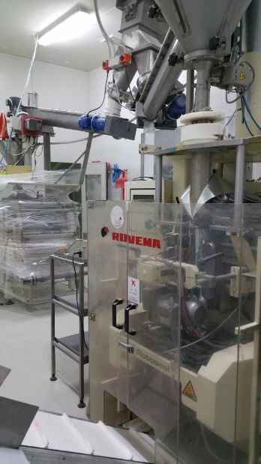
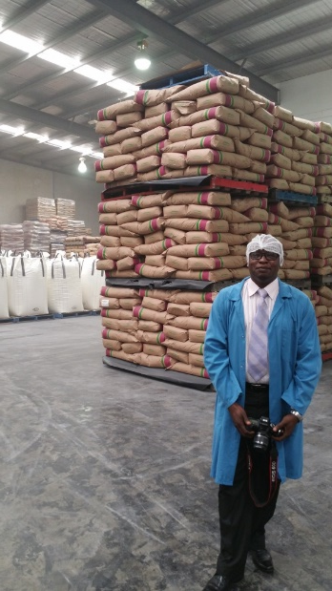
Packaging happens under strict hygiene conditions
Sydney Milk Powder is packaged under strict conditions that comply with Australian and international standards ensuring our product is the highest quality suitable for export

